Slide 1

SnackTrack
How to make food tracking
more attractive
START Hack Challenge 2024

Slide 2
Collecting health data is
Collecting nutritional data is
Motivating
Tedious
redundant
Easy
Useful
Useful

Slide 3
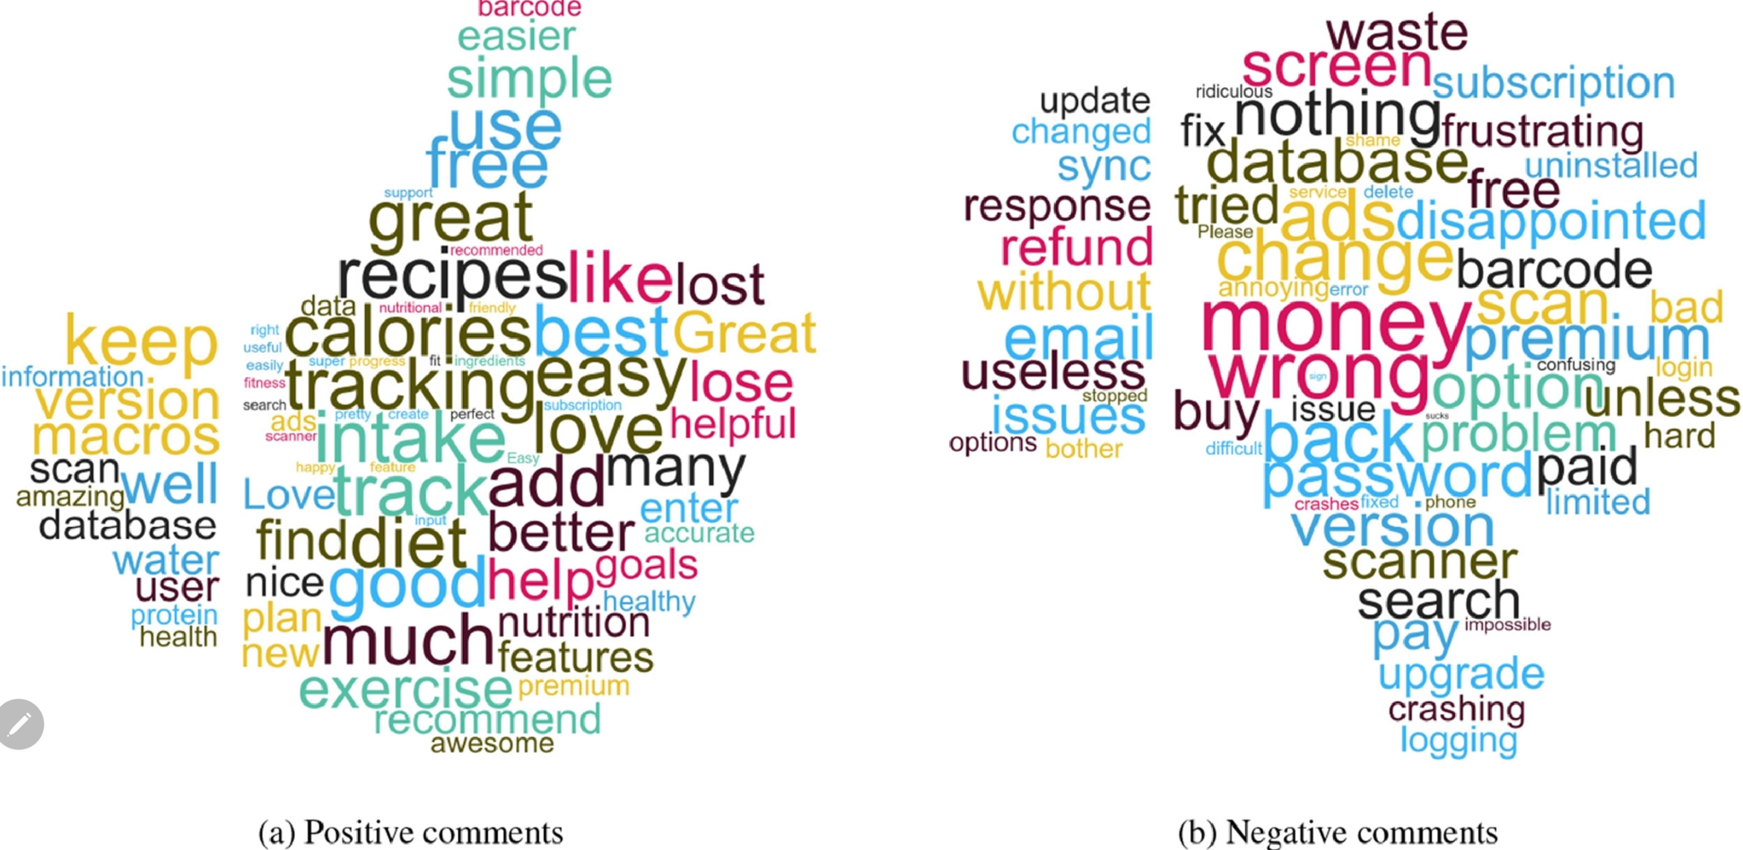
What Makes Food Tracking Apps (un)attractive?

Slide 4
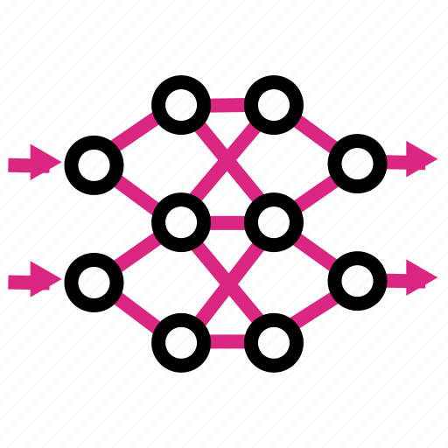
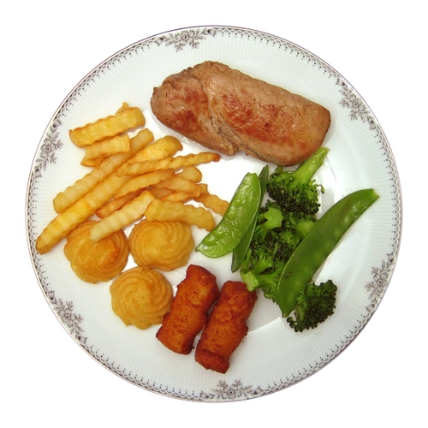
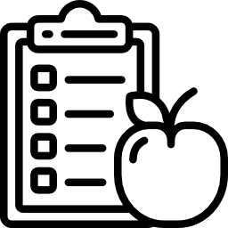
Usual (Poor Performing) Approach to Tracking
Image of meal
AI
Nutritional Information
So let’s “help” the food tracker,
Without making the task tedious

Slide 5

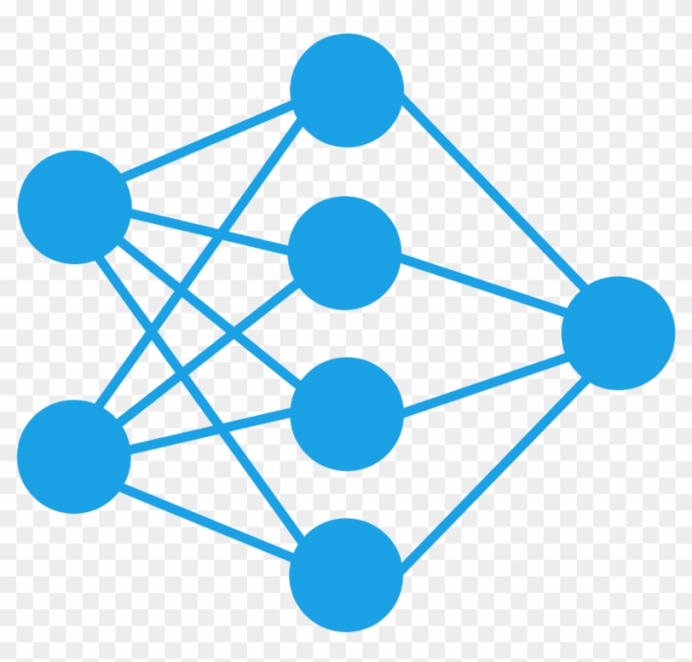


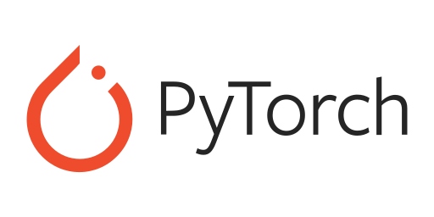
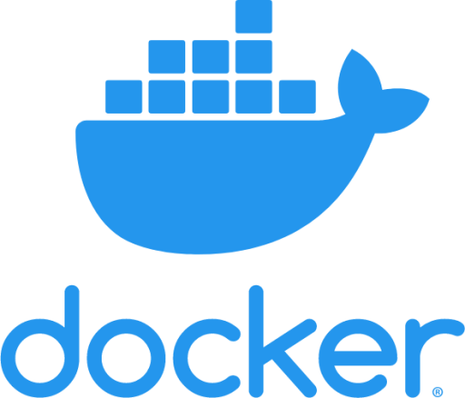
Our Approach
Nutritional
Info
3.
2.
Mass Prediction Model
Orchestrator
1.
Ingredient
Suggestion Model

Slide 6
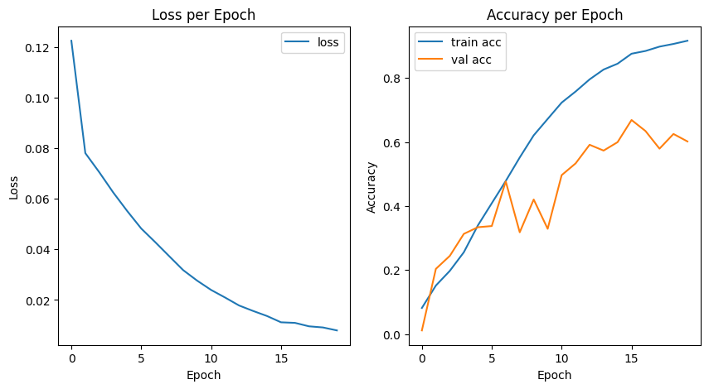
Ingredient Suggestion Model

Slide 7
Quote from Mattia Visigalli,
Innovation consultant at Zurich insurance
“Almost all heath insurances want to develop their personalised healthcare application and almost all of them have in their roadmap a project based on nutrition based project”

Slide 8
UX

Slide 9
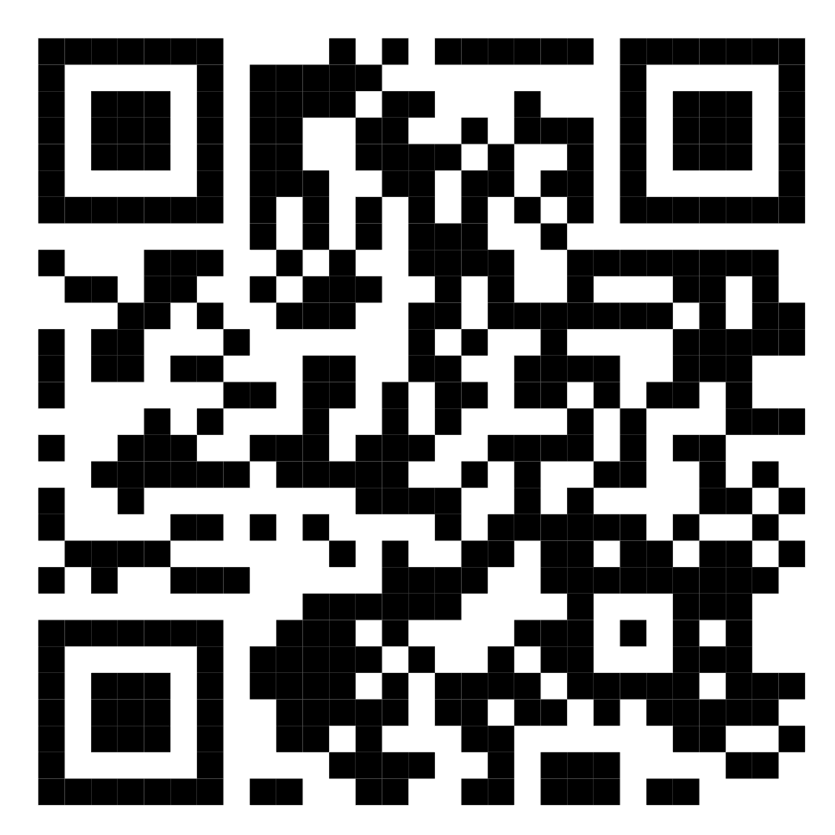

Find our code on GitHub

